Slide 1
A Monte Carlo Tree Search for the Optimisation of Flight Connections
Arnaud Da Silva , Ahmed Kheiri
Lancaster University, Department of Management Science, Lancaster LA1 4YX, UK
{a.dasilva, a.kheiri}@lancaster.ac.uk
Notes:
Hello all, today I am going to present the work I have dine during my maters thesis at LU in the UK to complete my MSc in BA under the supervision of Ahmed Kheiri

Slide 2
Agenda
Introduction
Problem description
Methodology
Computational results
Conclusion
Notes:
Before we dive into the details, let me walk you through the structure of today’s presentation.
1. First, I’ll start with the Introduction, where I’ll provide some context for the problem, discuss the research gap, and outline our contributions.
2. Next, I’ll move to the Problem Description, where I’ll explain the objectives, constraints, and mathematical formulation of the problem.
3. In the Methodology section, I’ll introduce the Monte Carlo Tree Search algorithm, highlight key policies we implemented, and explain how parallelization was applied.
4. Then, I’ll present the Computational Results, showcasing the performance of our approach and comparing it to state-of-the-art methods.
5. Finally, I’ll wrap up with the Conclusion, summarizing our key findings and discussing future work.
Let’s begin with the introduction.

Slide 3
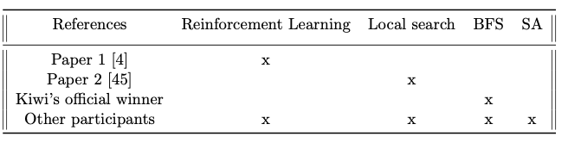
Introduction
The number of flight connections is growing rapidly, with over 38 million flights scheduled in 2023 [1].
Finding optimal and cost-effective flight routes is challenging, especially for multi-city journeys.
Kiwi.com introduced the Travelling Salesman Problem 2.0 (TSP 2.0) challenge.
Contribution: This study implements a novel Monte Carlo Tree Search (MCTS) algorithm to tackle this NP Hard problem.
Notes:
The number of flight connections continues to grow every year, with over 38 million flights scheduled in 2023. While this growth offers more travel options, it also makes finding the best and cheapest flight routes increasingly challenging, especially for multi-city journeys. To address this, platforms like Google Flights and Kiwi.com have developed advanced trip planner algorithms.
Kiwi.com has introduced a series of challenges to improve these algorithms. One such challenge, the Travelling Salesman Problem 2.0, is the focus of this study. Despite its complexity, limited research exists on solving this problem. Existing methods have included breadth-first search and heuristics like simulated annealing and reinforcement learning.
Our contribution is to tackle this problem using a novel approach: Monte Carlo Tree Search, or MCTS. Let’s move on to the problem description.”

Slide 4
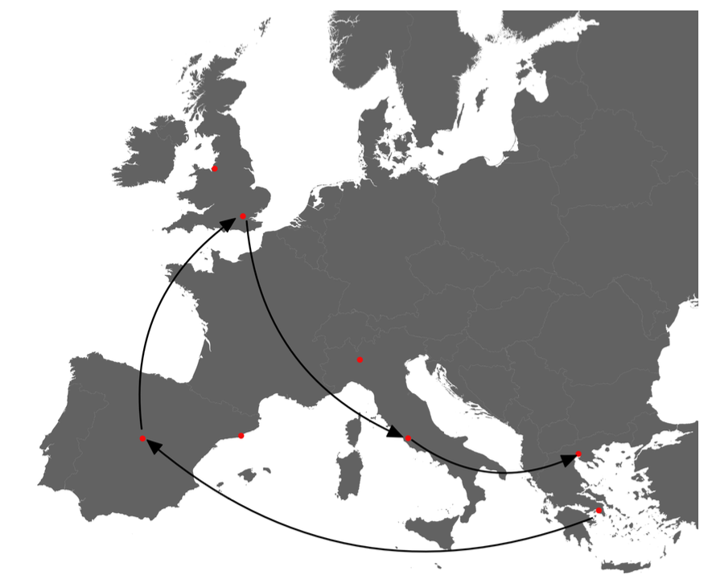
Problem Description
Variant of the TSP: generalised, asymmetric and time dependant.
Traveler must visit a set of areas, one per day, starting from a given airport, with various flight connections between these airports on different days.
Objective: determine cheapest flight route that allows the traveller to visit all the areas and return to the starting area.
Key Features:
1. Costs vary by direction and day but not time of day.
2. The trip starts and ends in the same area.
3. Arrival and departure must occur at the same city within an area.
Constraints:
Start from a specified airport.
Visit exactly one city in each area per day.
Source: [4]
• Areas: Greece (Athens, Thessaloniki), Italy (Rome, Milan), Spain (Madrid, Barcelona),
UK (London, Liverpool).
• Route: Athens → Madrid → London → Rome → Thessaloniki.
Notes:
The Kiwi.com problem requires finding the cheapest flight route across n areas, where an area consists of multiple cities or airports. The goal is to minimize total travel costs, but the problem has several unique features:
• First, flight costs depend on the direction of travel and the day of travel, but not on the time of day.
• Second, the trip must start and end in the same area, though not necessarily the same city.
• Third, once you arrive in a city within an area, you must also depart from that same city.
To describe this mathematically:
• We define Area as a set of n areas, each with multiple airports.
• Flight costs, denoted as c^d_{ij}, represent the cost of traveling from airport i to airport j on day d. These costs are:
• Asymmetric: Flying from i to j may cost more or less than flying from j to i.
• Time-dependent: Costs may change depending on the day.
The solution must also satisfy key constraints:
1. The trip starts from a specified airport.
2. Every day, exactly one city in a new area is visited.
3. The trip ends in the same area where it started.
To make this clearer, consider a simple example with 4 areas:
• Greece: Athens and Thessaloniki.
• Italy: Rome and Milan.
• Spain: Madrid and Barcelona.
• The UK: London and Liverpool.
If the trip starts in Athens, a valid route might be: Athens → Madrid → London → Rome → Thessaloniki. Notice that while the starting and ending airports differ, the trip is valid because it ends in the same area.
This structure introduces high complexity, as costs vary by direction and day. As a result, we need an efficient approach like Monte Carlo Tree Search to find a solution. I’ll now explain our methodology.

Slide 5
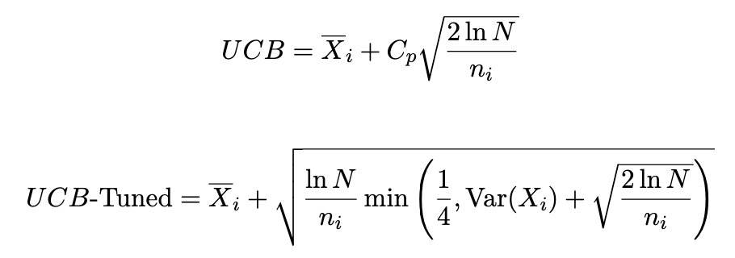
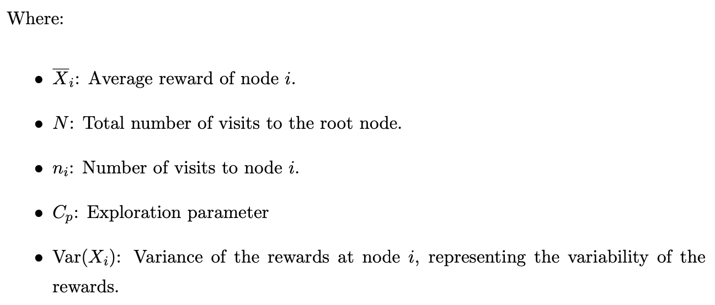
MCTS – different policies
Selection:
Simulation: Random, greedy, and tolerance-based methods.
Expansion:
Top-K Policy: Selects the top k cheapest flight connections, where k is determined by the maximum number of children N_{c}.
Ratio Policy: Combines the top-k selection with randomness:
A fraction c of nodes are the cheapest actions.
The remaining (1- c)*N_{c} actions are chosen randomly.
Parralelisation:
Simulations distributed across multiple cores to improve efficiency.
Notes:
The Cp coefficient can also be considered in UCB1-Tuned’s formula
This policy selects an action randomly from a subset of actions that are within a certain tolerance level of the minimum cost action. The tolerance level is defined by c

Slide 6
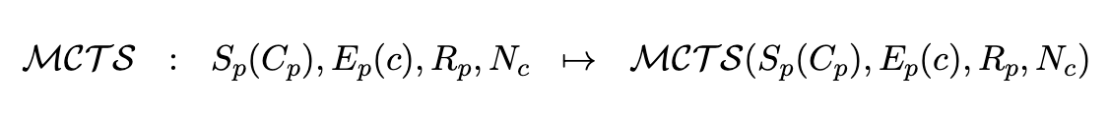
MCTS definition

Slide 7
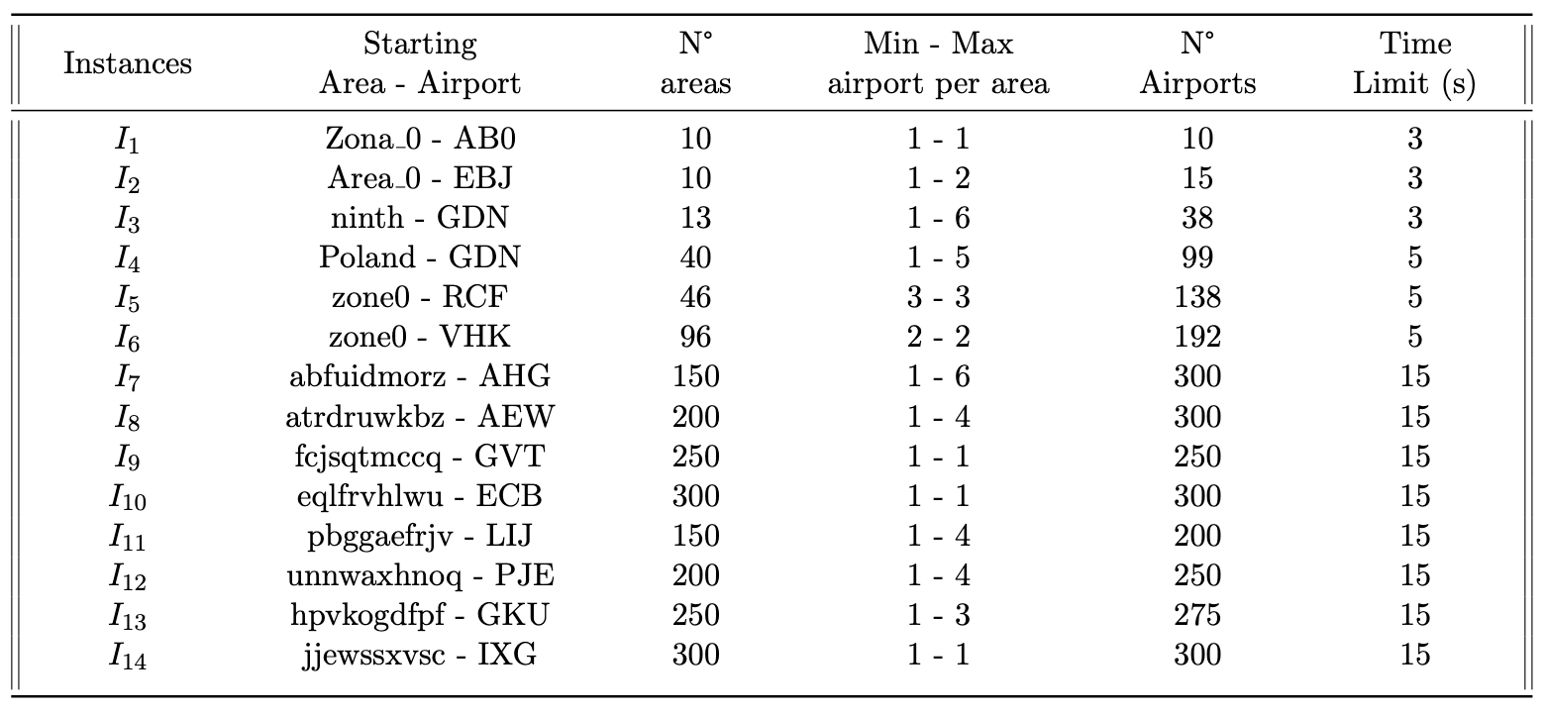
Hypothesis
No focus on time limit
Notes:
No focus Time limit: computational budget is limited when using Python

Slide 8
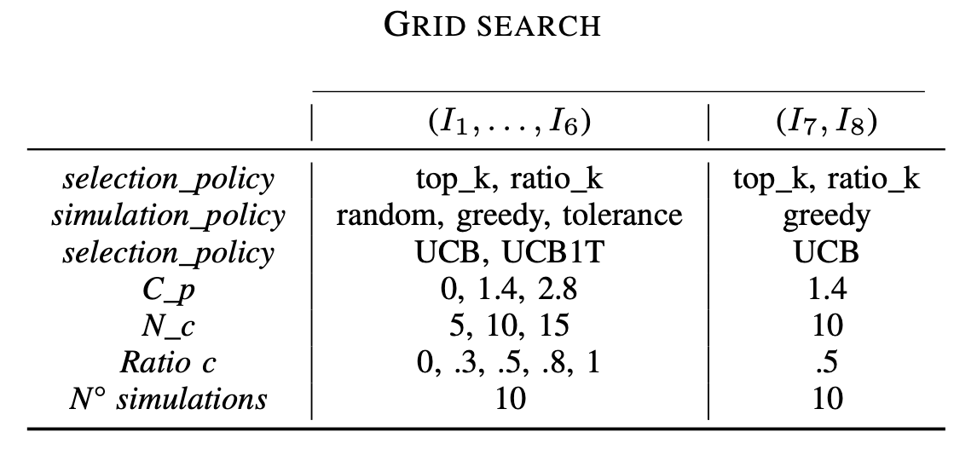
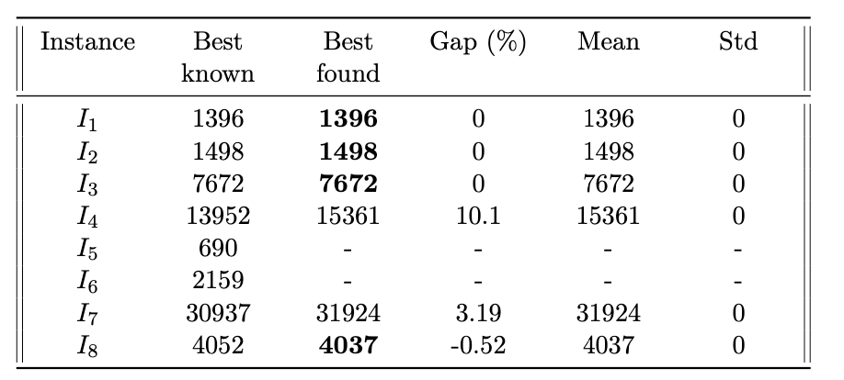
Computational Results
Setup: Python on an Intel i7 CPU with 8 cores.
Notes:
We tested our approach on eight problem instances, labeled I_1 through I_8. These instances varied in complexity, and our experiments were run on a standard Intel i7 CPU with Python.
Here are the highlights:
• For smaller instances like I_1, I_2, and I_3, our MCTS algorithm matched or exceeded state-of-the-art solutions.
• For I_8, we achieved a new best solution, improving the known result by 0.52%.
• UCB1-Tuned outperformed classic UCB, thanks to its better balance of exploration and exploitation.
• The greedy simulation policy consistently led to the best results, minimizing total travel costs.
• Parallelization significantly improved the efficiency of our approach, particularly for larger instances like I_4.
Overall, these results validate the effectiveness of our method.

Slide 9
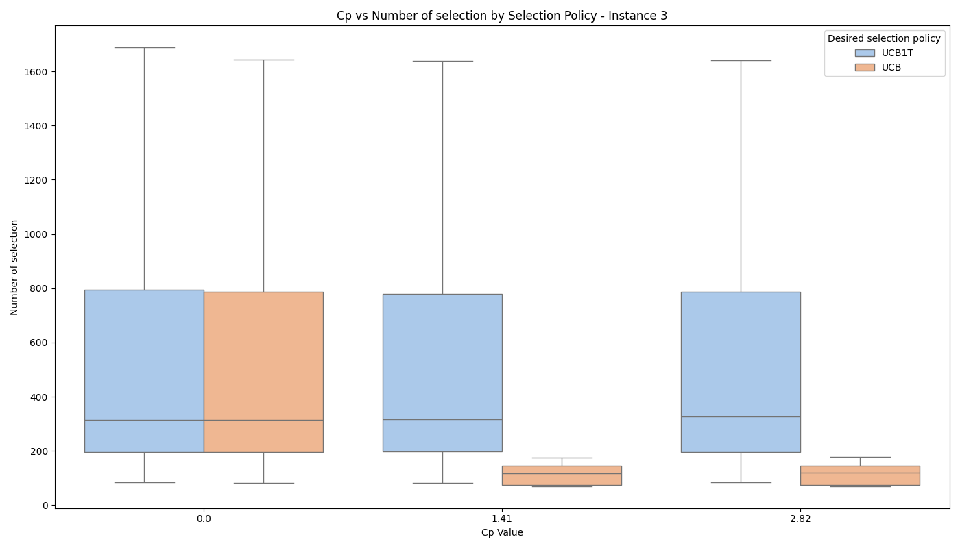

Deep dive – I₁ to I₄
C_{p} = 0 leads to the same performance

Slide 10
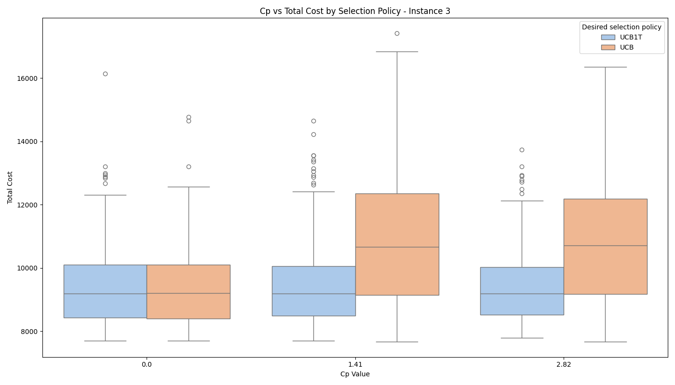
Deep dive – I₁ to I₄
UCB vs. UCB1T: Higher exploration parameter C_{p} in UCB = faster convergence but often worse outcomes compared to UCB1T.
UCB1T Performance: UCB1T requires more time but explores more effectively, yielding better overall results.

Slide 11
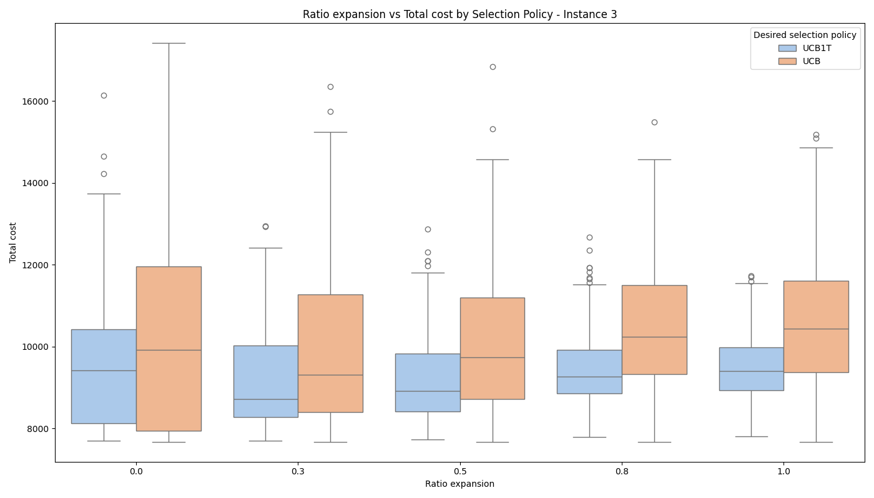
Deep dive – I₁ to I₄
UCB is more tied to expansion ratio but underperforms UCB1T, which balances exploration better.
Notes:
Finally, the UCB policy exhibits a stronger correlation with the expansion ratio compared to UCB1T. Despite this correlation, UCB’s overall performance is
inferior to that of UCB1T. This is because UCB relies more heavily on exploitation, whereas UCB1T, though slower to converge, achieves better results by balancing exploration and exploitation more effectively.

Slide 12
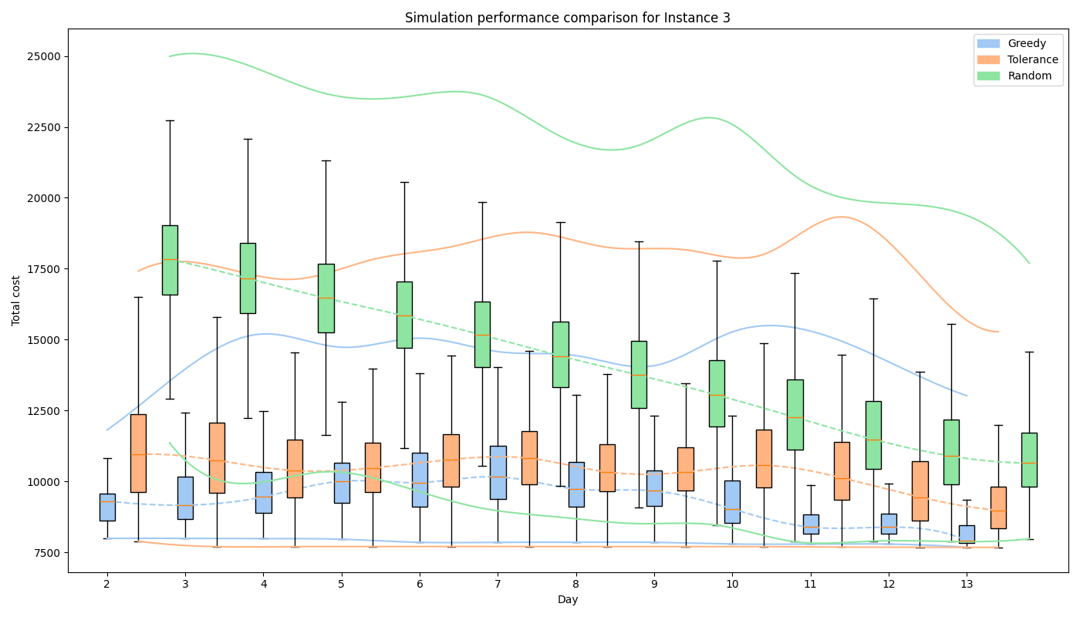
Deep dive – I₁ to I₄
Greedy policy outperforms with consistently lower costs and faster convergence.
A well-calibrated set of parameters for the MCTS should converge towards the minimum cost found during the simulations.
Notes:
presents box plots for the different simulation policies applied to Instance 3. For each day, the distribution of the simulated outcomes is plotted according to the simulation policy used. Coloured curves indicate the minimum and maximum values of these distributions, while dashed lines represent the medians.
the greedy simulation policy demonstrates superior performance, as evidenced by lower minimum, maximum, and median values of the simulation outcomes across all days. The pronounced convergence of the random policy reflects the inherent randomness of this approach. Additionally, for the greedy and tolerance policies, the minimum value is nearly reached by the second or third day of simulation. This suggests that a well-calibrated set of parameters for the MCTS algorithm should ideally converge towards the minimum cost observed during the simulations.
If the algorithm does not achieve this, it indicates that the MCTS parameterisation is not good enough to solve the pb.

Slide 13
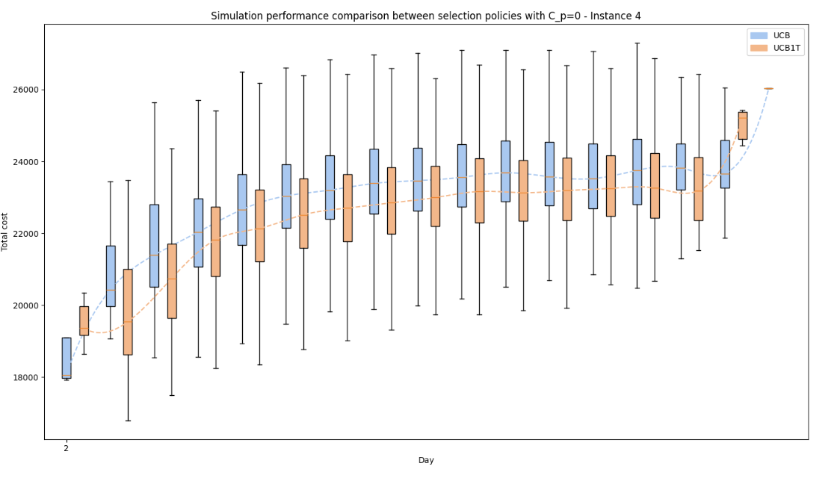
Deep dive – I₁ to I₄
Parametrisation of the MCTS is not efficient: search process does not converge towards the minimum found cost

Slide 14
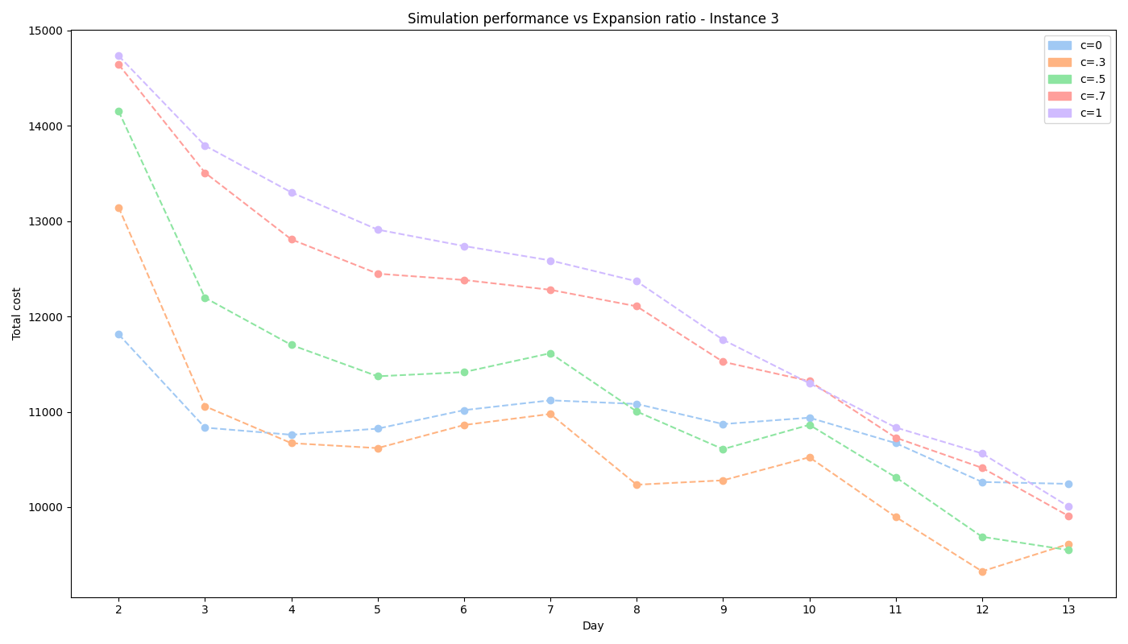
Deep dive – I₁ to I₄
Low c values guide the tree effectively for small instances, preventing overexpansion.
Notes:
In Figure 4, the median distributions for different scenarios are plotted. The analysis reveals that values of c too close to 1 do not, on average, converge to the minimum-cost solution.
In contrast, lower values of c tend to guide the tree search more effectively during the first days of simulations. This is crucial because it helps avoid excessive expansion of the search tree, which can lead to inefficient and time-consuming MCTS processes.

Slide 15
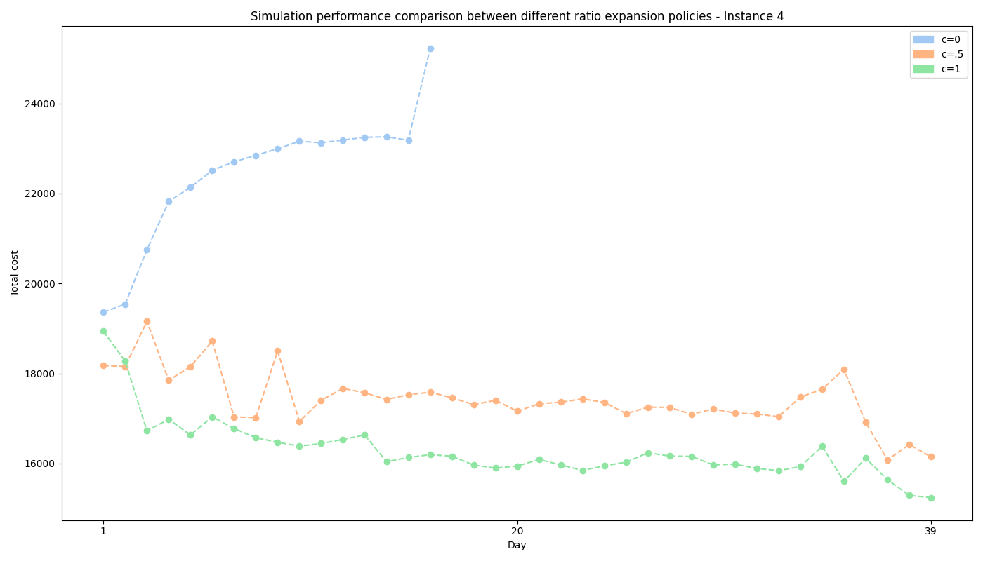
Deep dive – I₁ to I₄
c = 1 performs better, while c = 0 is inefficient and diverges from minimum costs.
Notes:
These conclusions apply to smaller instances. However, for instance I4, as shown in Figure 5, having c = 0 with a greedy selection policy proves inefficient. The search tree diverges from the minimum simulated cost, resulting in the tree search failing to find a solution within 10 minutes. Based on the median comparison, c = 1 emerges as a more optimal parameter for guiding the tree search in this case.

Slide 16
I₅ and I₆
MCTS struggled with the defined grid search, failing to guide the tree effectively.
Stochastic policies occasionally find solutions but rarely lead the search to terminal states, causing tree pruning.

Slide 17
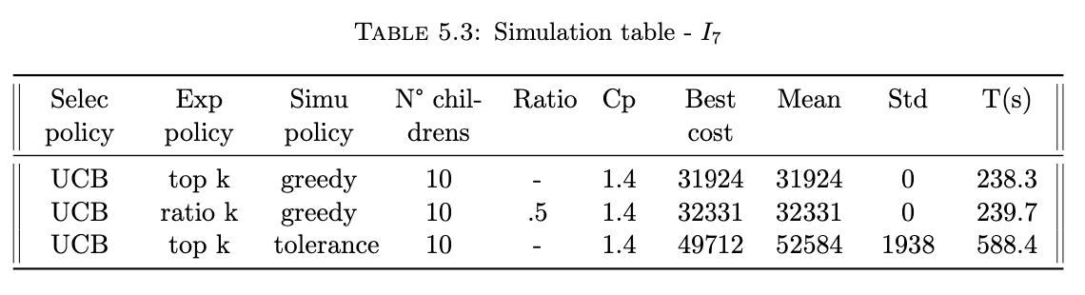
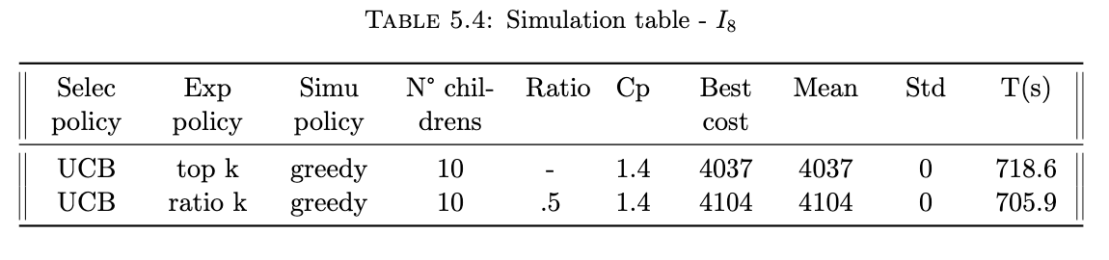
Deep dive – I₇ and I₈
For I₇, solutions were within 3.2% of the best known, with the greedy policy outperforming tolerance and random policies.
For I₈, a new state-of-the-art solution was found, improving the cost by 0.52%.

Slide 18
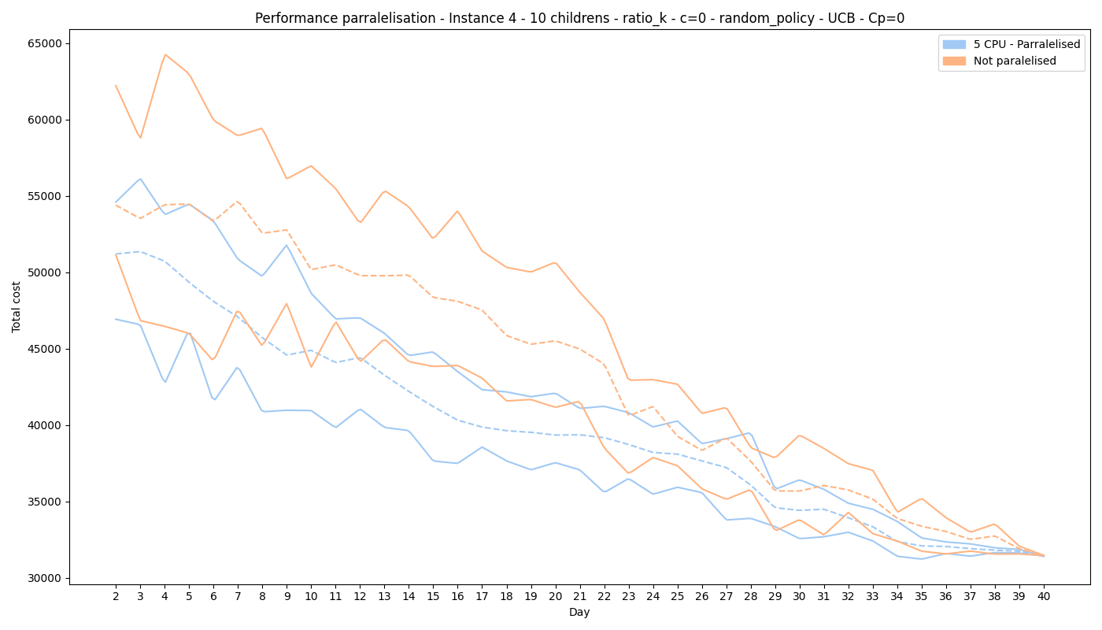
Parralelisation
5-Core Parallelisation: Significantly improves MCTS performance in stochastic environments by guiding the search effectively in early stages.
Notes:
In our implementation for instance I4, we parallelised the MCTS across five cores. The parameters were selected to illustrate the effects of parallelisation in a stochastic environment. The parallelisation was applied during the simulation phase of the MCTS, with the minimum outcome from the five parallel simulations being chosen as the final result.

Slide 19
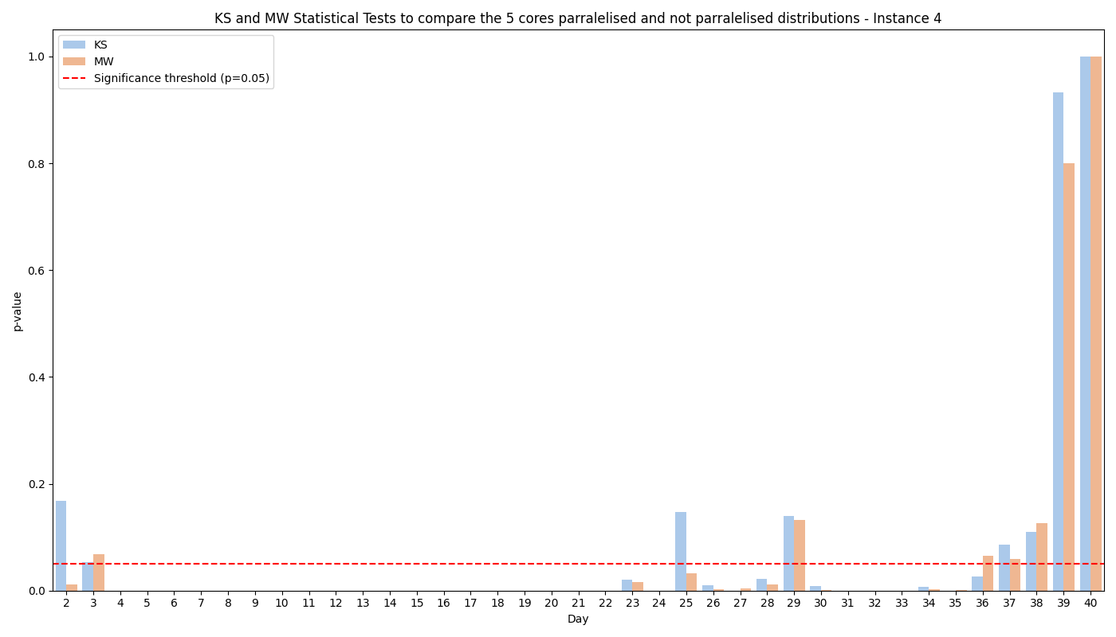
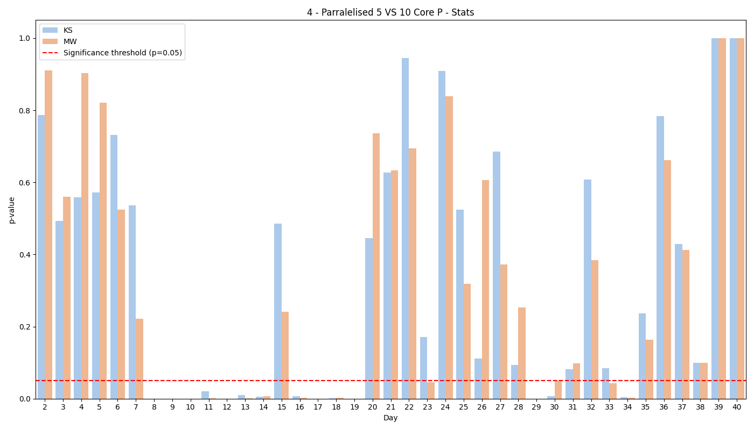
Parralelisation
5 cores parallelisation vs no parallelisation: Mann-Whitney and Kolmogorov-Smirnov tests confirm better performance of 5-core parallelisation at a 5% significance level.
5 vs. 10 Cores: Increasing to 10 cores shows no statistical improvement, aligning with findings that excessive modifications can hinder MCTS performance.

Slide 20
Conclusion
MCTS Performance:
Solved 8 instances of Kiwi.com TSP 2.0; a new state-of-the-art solution was found for I₈.
UCB1-Tuned outperformed UCB but requires more time to converge.
Greedy simulation policy consistently delivered the best results.
Random and tolerance policies are less effective for complex instances.
Recommendations:
Use Top-K expansion policy for superior performance.
Implement parallelisation, especially for stochastic simulations, to handle complex instances effectively.
Notes:
To conclude, we successfully implemented Monte Carlo Tree Search to solve Kiwi.com’s Travelling Salesman Problem 2.0. Our method achieved state-of-the-art solutions for smaller instances and even outperformed existing benchmarks for I_8.
The key factors contributing to our success include:
• The use of UCB1-Tuned for selection, which improved exploration.
• A greedy simulation policy that consistently found optimal routes.
• The introduction of parallelization to enhance computational efficiency.
In the future, we plan to optimize our approach for larger instances and explore hybrid models that combine MCTS with other heuristics. Thank you for your attention, and I’m happy to take any questions.

Slide 21
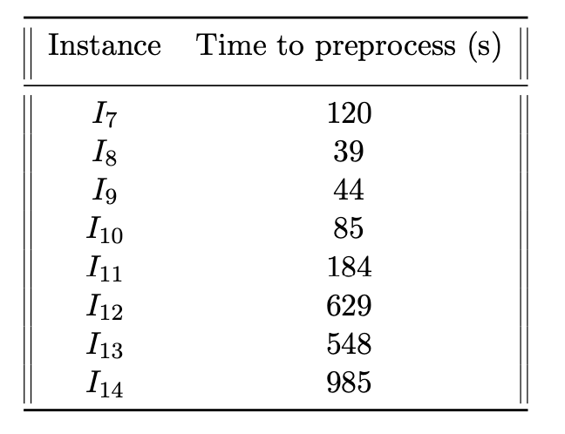
Areas for expansion
Code a solution in a faster programming language
Implement efficient parralelisation
Redefine parameters of the MCTS
Integrate reinforcement learning within simulation policies

Slide 22
References
[1] Statista, “Number of flights performed by the global airline industry from 2004 to 2023, with a forecasts for 2024,” https://www.statista.com/statistics/564769/airline-industry-number-of-flights/, 2024.
[2] At the University of Strathclyde John Levine for his class CS310: Foundations of Artificial Intelligence. Monte carlo tree search, 2017. URL https://www.youtube.com/watch?v=UXW2yZndl7U&t=385s. Accessed: June, 2024.
[4] Y. Pylyavskyy, A. Kheiri, and L. Ahmed, “A reinforcement learning hyper-heuristic for the optimisation of flight connections,” in 2020 IEEE Congress on Evolutionary Computation (CEC), 2020, pp. 1–8.
[3] Kiwi.com, “Travelling salesman challenge 2.0: Award ceremony,” Youtube, 2019. [Online]. Available: https://www.youtube.com/watch?v=p7LaEUwCjE
[45] M. Alrasheed, W. Mohammed, Y. Pylyavskyy, and A. Kheiri, “Local search heuristic for the optimisation of flight connections,” in 2019 International Conference on Computer, Control, Electrical, and Electronics Engineering (ICCCEEE), 2019, pp. 1–4.
[5] C. Browne, E. J. Powley, D. Whitehouse, S. M. Lucas, P. I. Cowling, P. Rohlfshagen, S. Tavener, D. Perez, S. Samothrakis, and S. Colton, “A survey of monte carlo tree search methods,” IEEE Transactions on Computational Intelligence and AI in Games, vol. 4, no. 1, pp. 1–43, 2012.

Slide 23
Thank you!
Any questions?

Slide 24
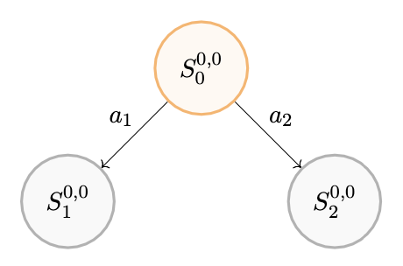
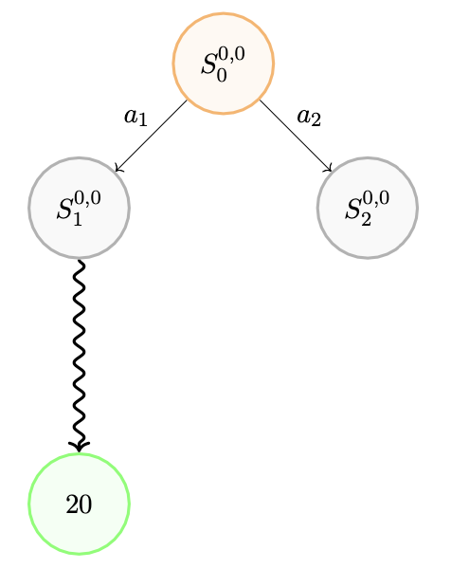
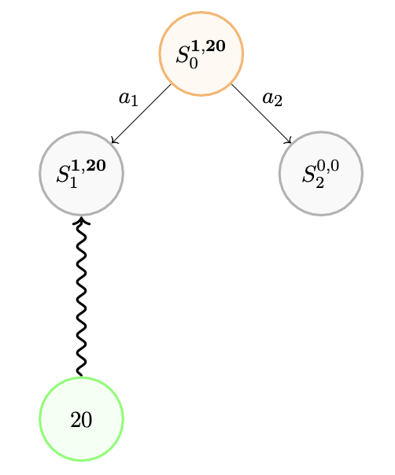
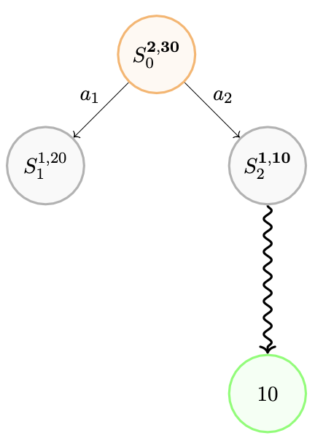
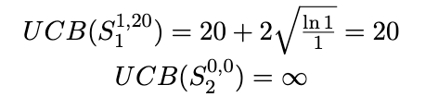
MCTS flow – Iteration 1
Phases: Selection, Expansion, Simulation, Backpropagation.
Source: Based on concepts explored in the video Monte Carlo Tree Search by John Levin (Youtube) [2]
Notes:
Maximisation problem / game
Initial state is S0

Slide 25
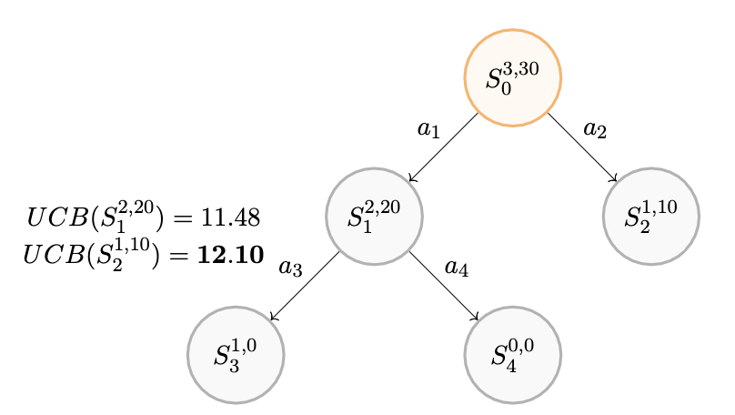
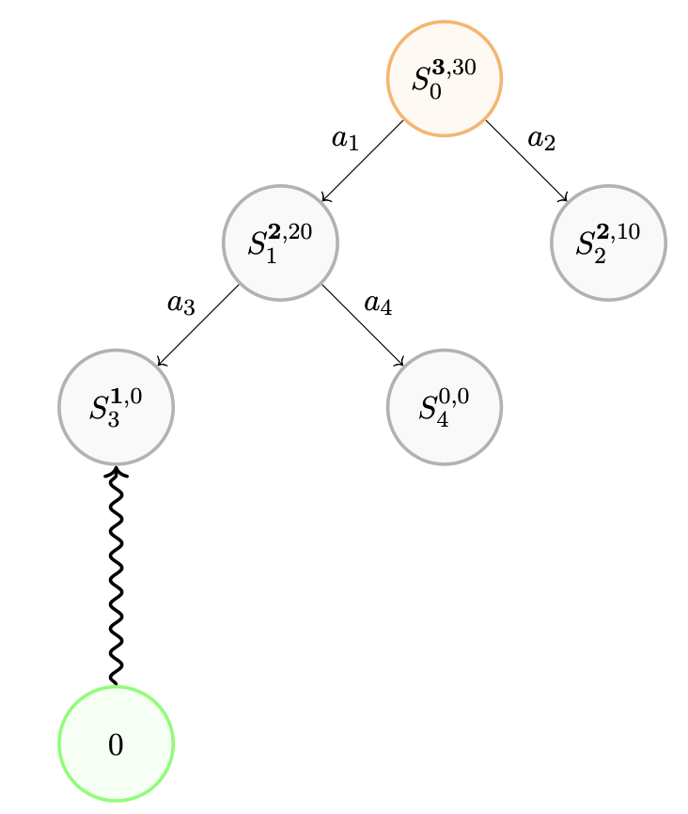
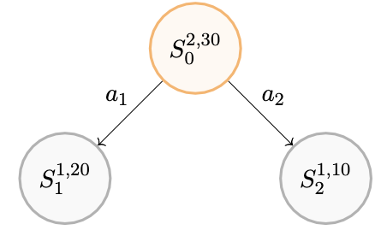
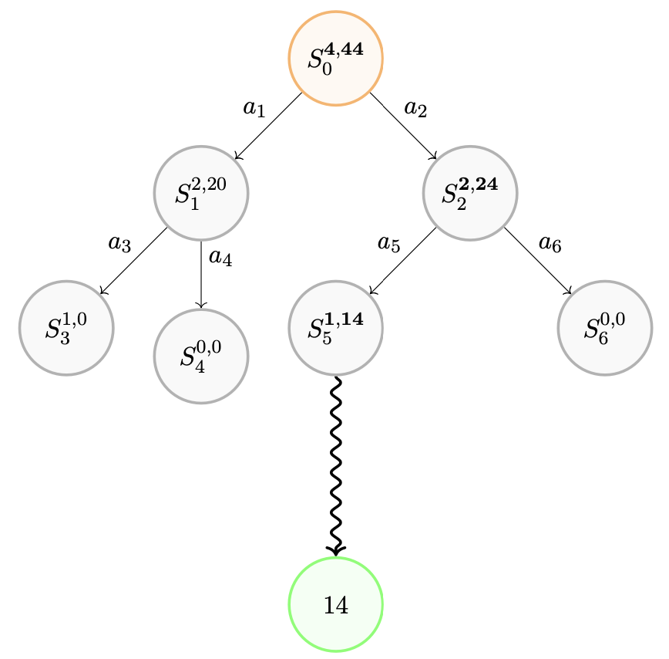

MCTS flow – Iteration 2
Source: Based on concepts explored in the video Monte Carlo Tree Search by John Levin (Youtube) [2]

Slide 26
Appendix

Slide 27
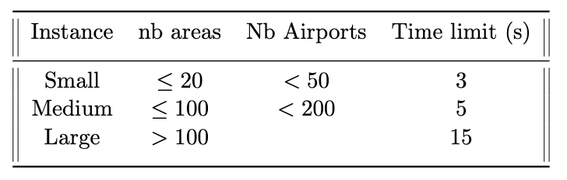

Slide 28
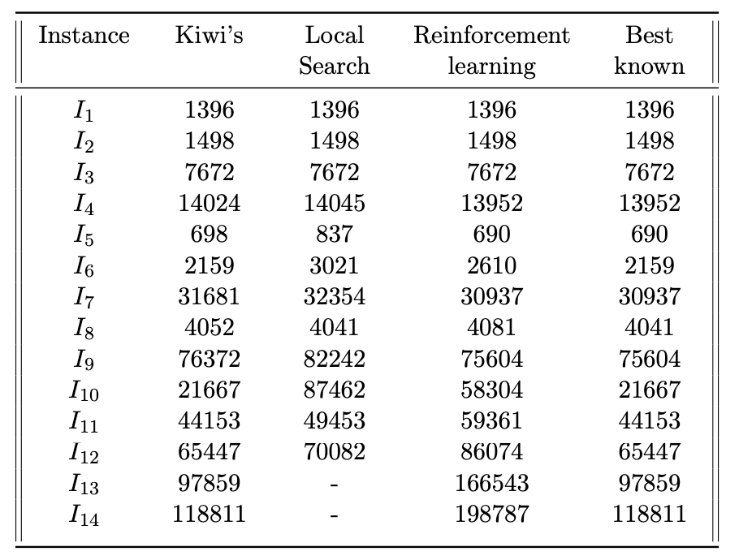

Slide 29
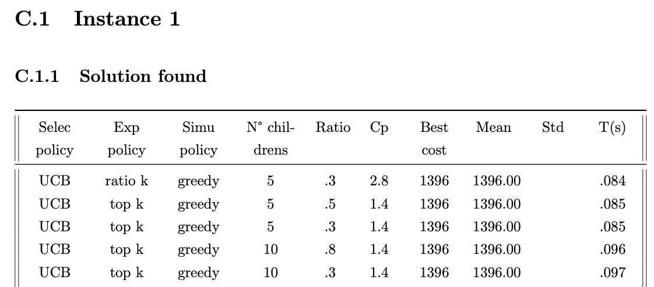
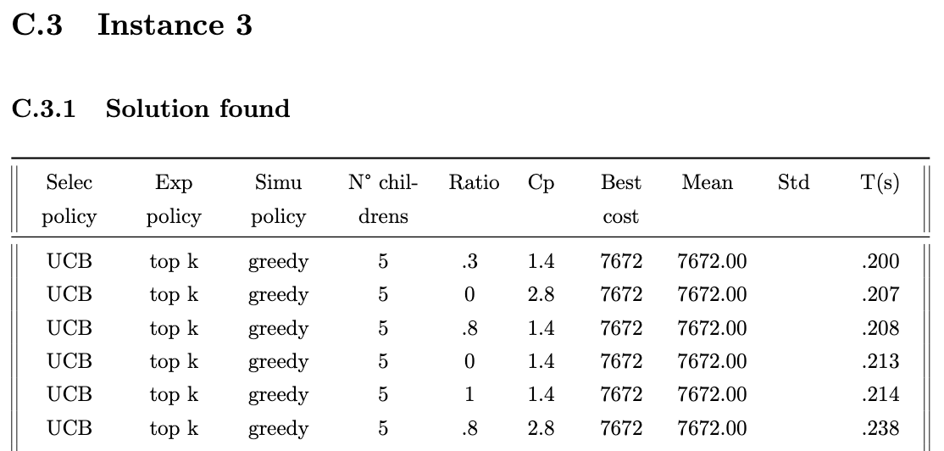
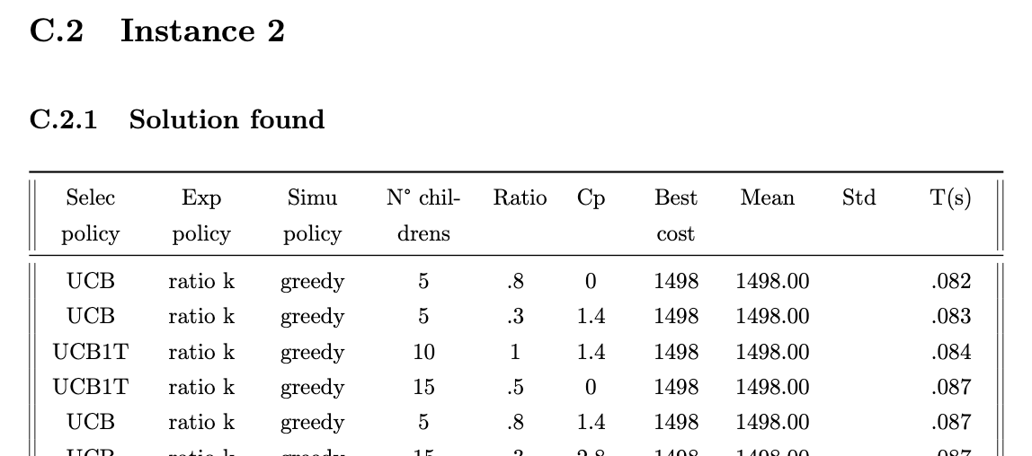
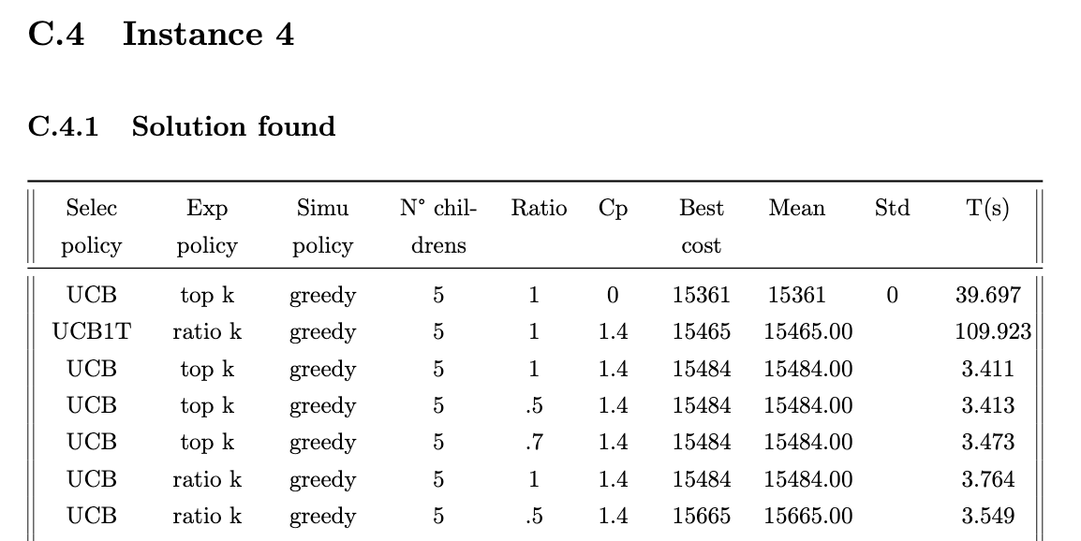

Slide 30
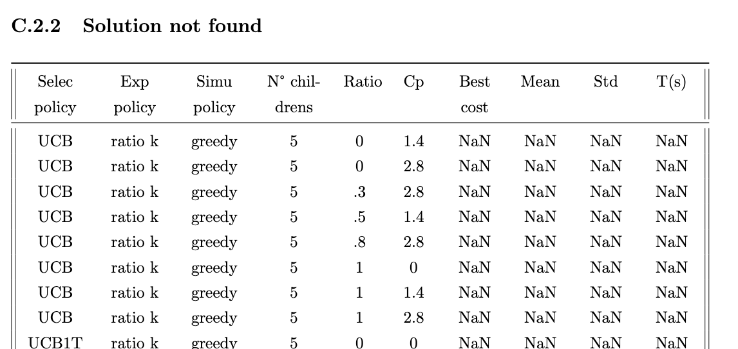

Slide 31
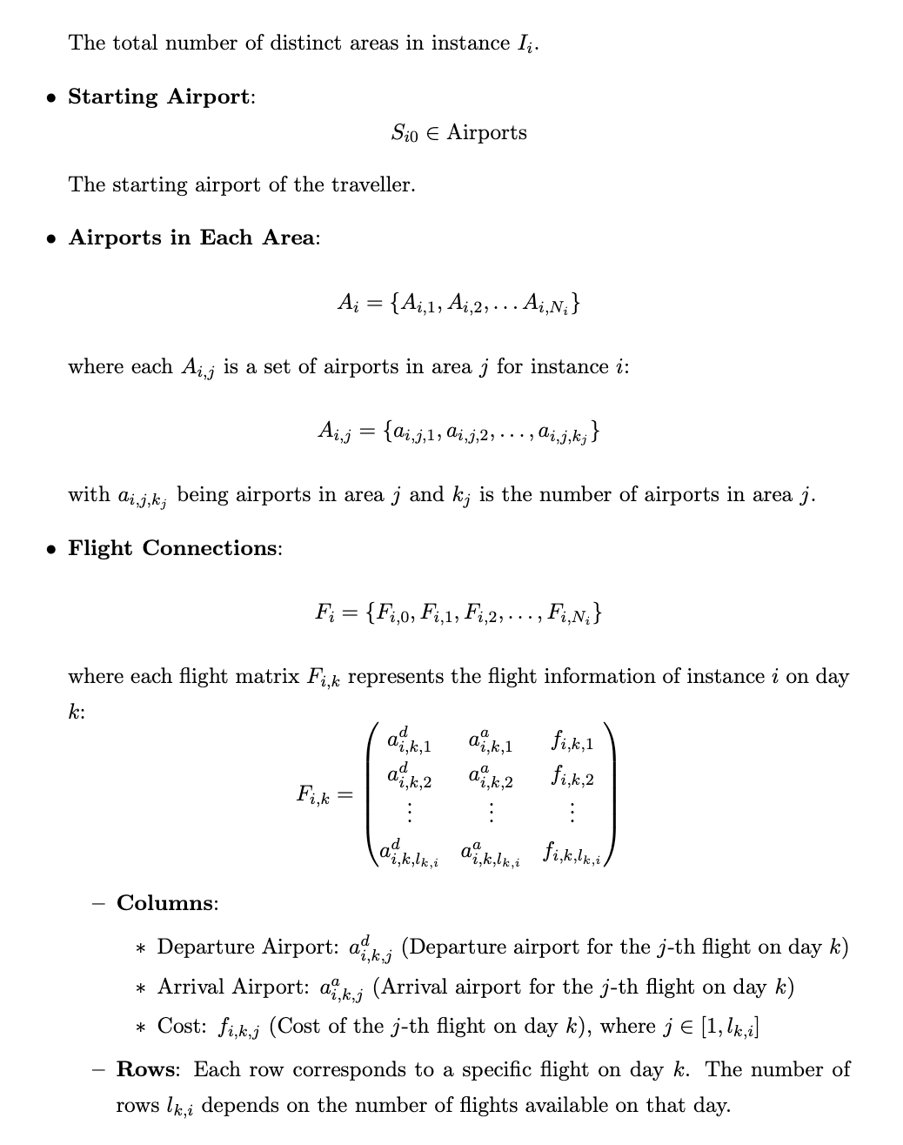
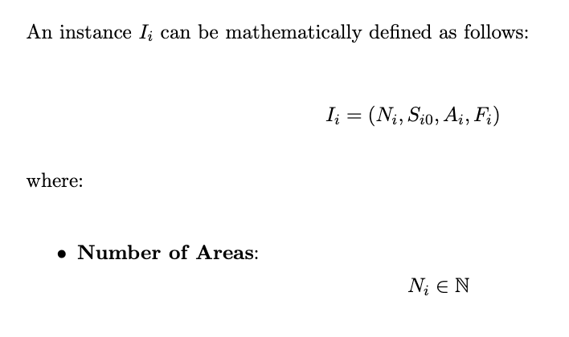

Slide 32
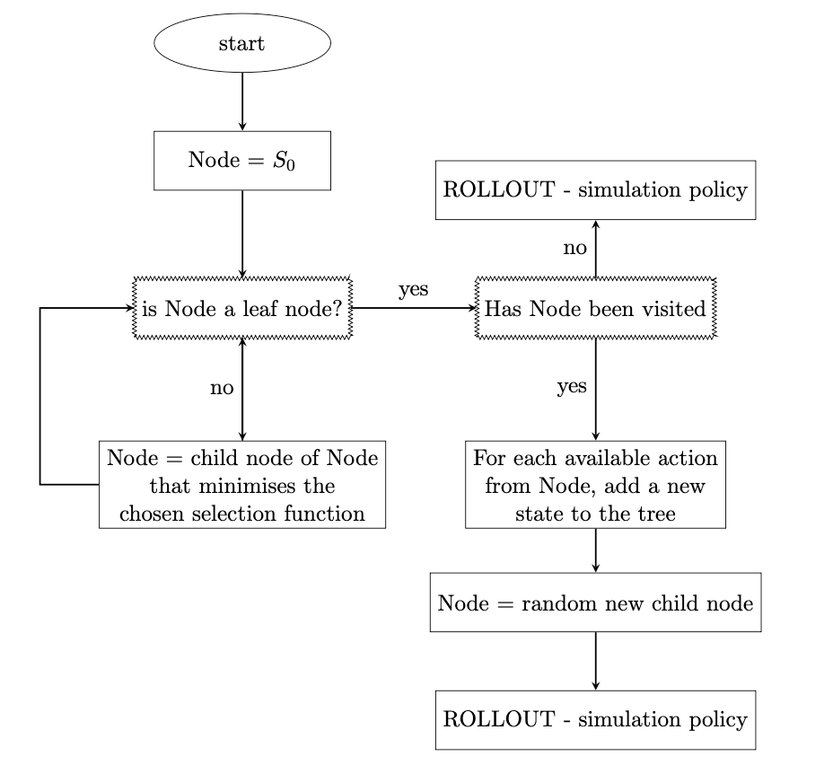
Source: Based on concepts explored in the video Monte Carlo Tree Search by John Levin (Youtube) [2]

Slide 33
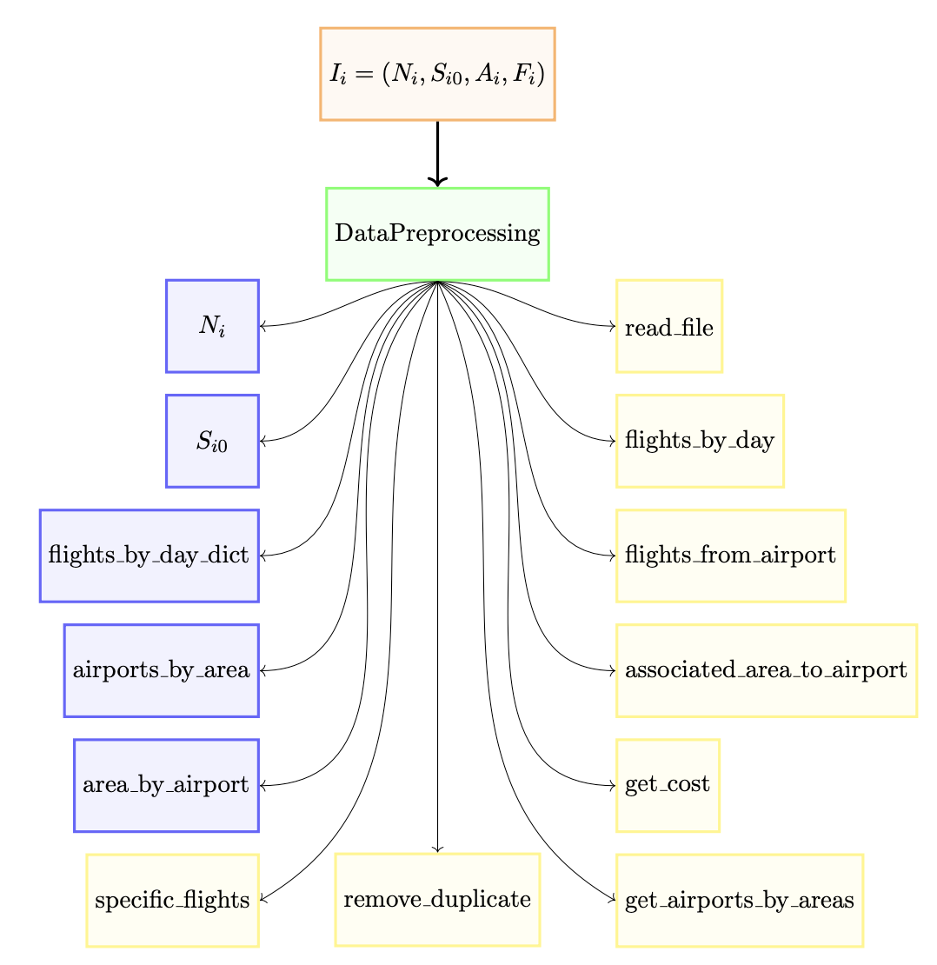
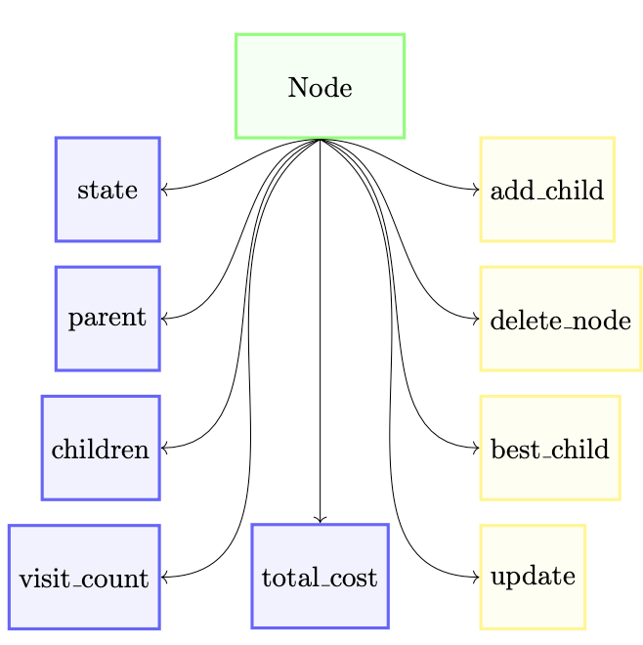

Slide 34
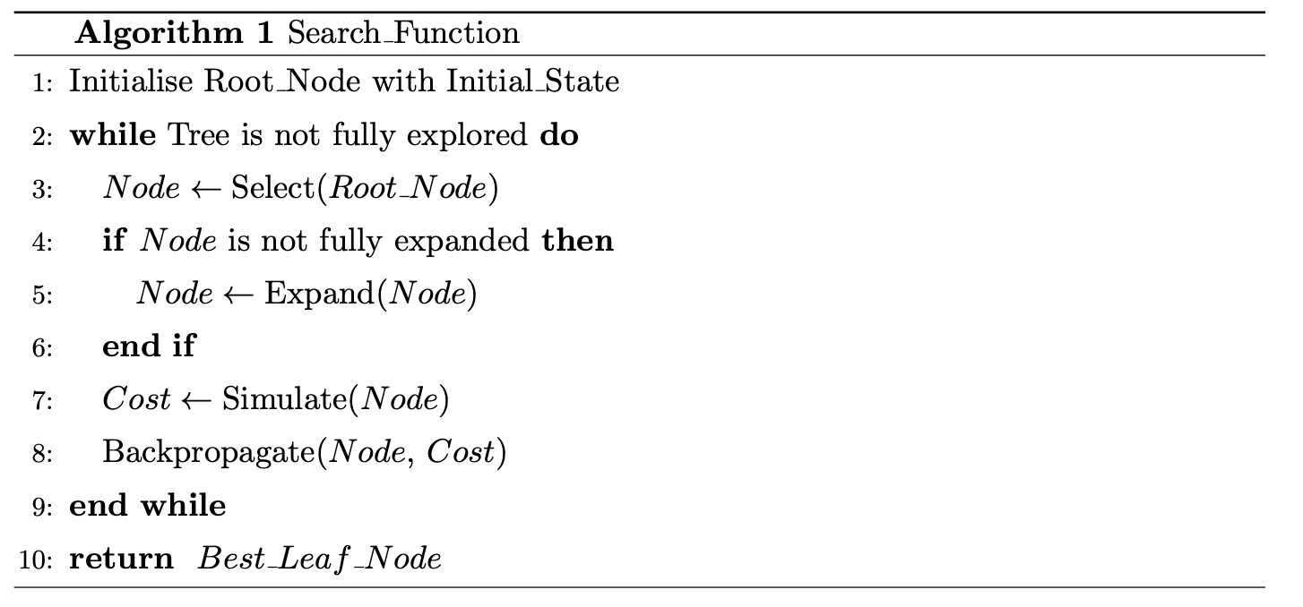

Slide 35
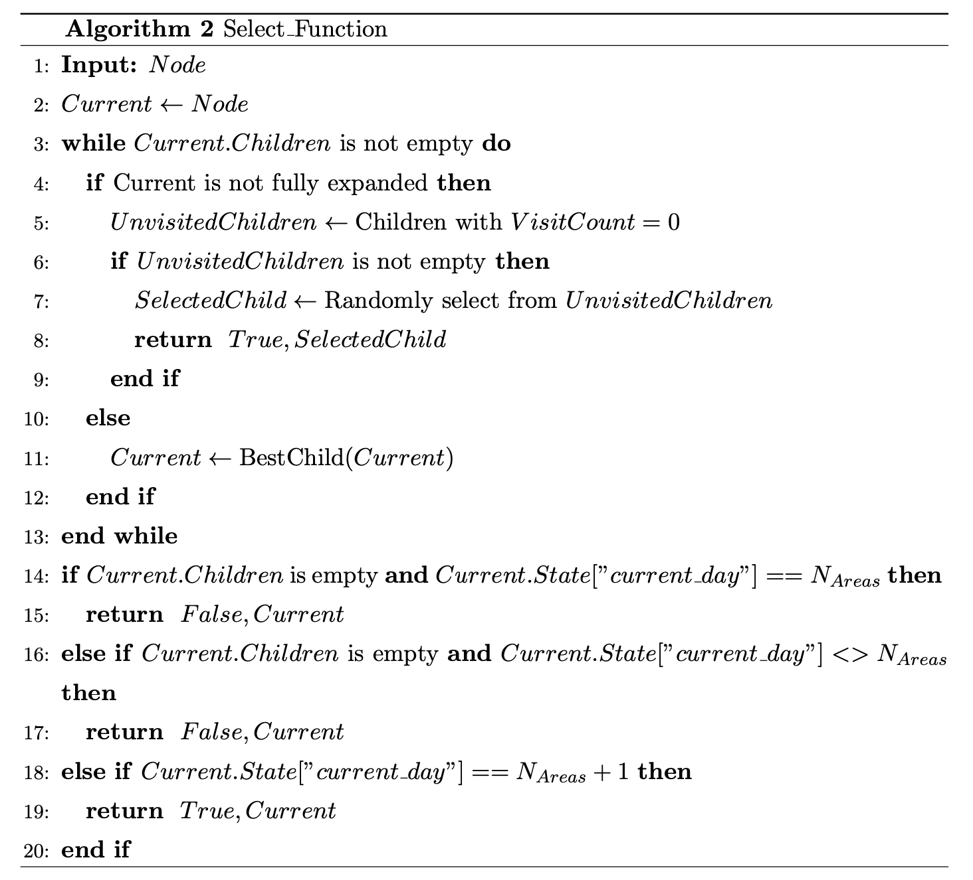

Slide 36
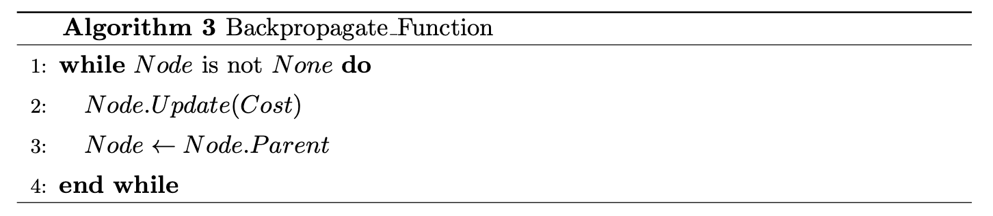
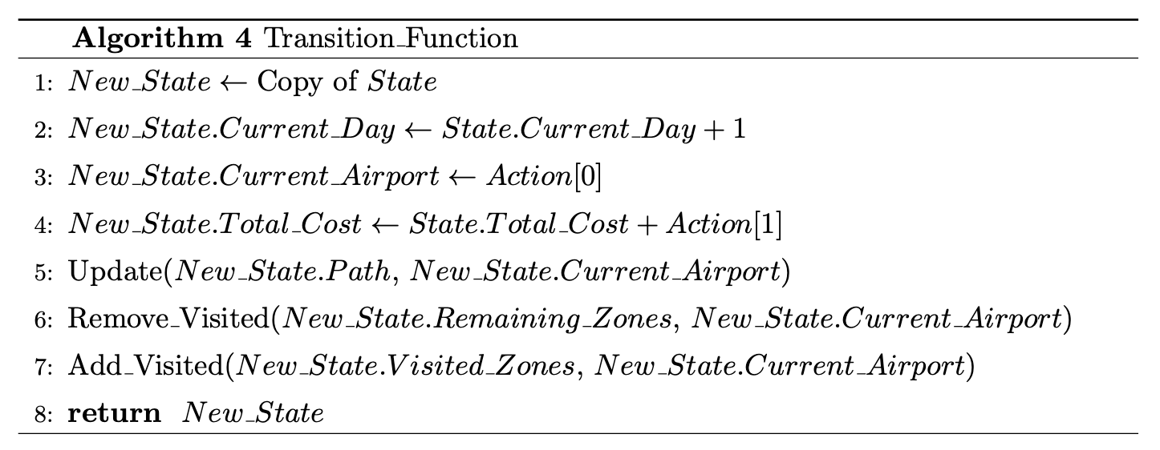

Slide 37
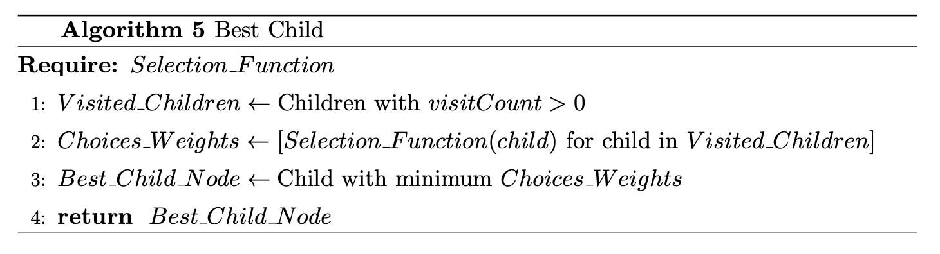

Slide 38
Statisticals test
Mann-Whitney Test: Compares two groups to determine if their distributions differ significantly.
Kolmogorov-Smirnov Test: Assesses if two samples come from the same distribution by comparing their cumulative distributions.

Slide 39
